Slide 1



SENSITIZATION OF CHILD PROTECTION COMMITTEES
WEST BENGAL
Block: District:
Date:

Slide 2
Objectives:
The guidelines is developed, considering the norms and visions of Integrated Child Development Schemes (ICPS) will following set of objectives expected to be fulfilled by the Child Protection Committee (CPC):
Building community awareness and consciousness on child right;
Promoting behavior change among parents and community in the best interest of child;
Monitoring and reporting of child right violation case in the community in the best interest of child;
To raise awareness in the community about Government programmes and schemes for children;
Identify vulnerable children in the community and prepare Child Protection Plan covering each child and sharing it with competent authority (Child Welfare Committee, Juvenile Justice Board, Police & Judiciary);
Maintain confidentiality in each case.

Slide 3
Introduction to Child Protection Committees:
A CPC is a community based group including duty bearers, who are primarily responsible for creating and promoting a child friendly and safe community environment wherein all children’s well-being, safety and right are protected.
The CPCs will be responsible for monitoring, reporting and responding to the issues of child protection in the community;
The CPCs will plan and take up innovative activities to raise awareness in the community about the issue of local child protection concerns;
The CPCs will work in close coordination with the DCPU for activities in the community on child protection issues;
The CPCs will develop Annual Action Plans to address issues of child protection;
The CPCs will refer and report cases to higher level of protection committees and DCPU;
The CPCs will engage various stakeholders and duty bearers to raise awareness on children’s rights and protection at community level

Slide 4
Introduction to Child Protection Committees:
The Child Protection Committee (CPC) will be at two level, one at the sansad/ward and second at the block level. The District Child Protection Unit will coordinate at the district level for child protection .
Level 1: Village Level Child Protection Committee (VLCPC) –
The VLCPC will be established in each sansad/ward state for prevention, reporting, monitoring, protection & responding the issues of child rights and protection.
Level 2: Block Level Child Protection Committee (BLCPC) –
The BLCPC will support the VLCPCs in planning, budgeting, developing awareness raising activities, formation of VLCPCs, capacity building etc. as per ICPS guidelines in coordination with DCPU. The BLCPC will also take periodic reports from VLCPCs, submit the reports to DCPU along with action taken report. The BLCPC will also work as a referral point for VLCPCs to support them in addressing cases of child protection and child rights violation.

Slide 5
Composition of Child Protection Committees:
Level 1: Village Level Child Protection Committee (VLCPC) –
SL | Suggested Member | No. | Reserved for Female | Designation
1 | Children Representative (12-18 years) [If children’s group exist in the community, then Children Group will nominate, otherwise school teacher will nominate] | 4 | 2 | Member
2 | Anganwadi Worker | 1 | 1 | Treasurer
3 | School Teacher of local school [to be nominated by SI] | 1 |  | Member
4 | Auxiliary Nursing Midwife (ANM) | 1 | 1 | Member
5 | CBO/NGO/VHSC/women SHG [Chairperson to decide with Secretary] | 2 | 1 | Member
6 | Reputed & respected person from Community [Chairperson to decide with Secretary] | 2 |  | Member

Slide 6
Composition to Child Protection Committees:
Level 1: Village Level Child Protection Committee (VLCPC) –
SL | Suggested Member | No. | Reserved for Female | Designation
7 | Elected Representative of village [Chairperson to decide with Secretary] | 1 |  | Member
8 | Head of the Panchayat Raj Institution - Pradhan | 1 |  | Chairperson
9 | Parents from School Management Committee [Chairperson to decide with Secretary] | 1 |  | Member
10 | Anganwadi Supervisor [CDPO to nominate] | 1 | 1 | Convener/ Member Secretary
11 | Representatives from weaker section (SC, ST, Minority, Physically challenged) [Chairperson to decide with Secretary] | 2 | 1
 | Total | 15 | 7
Member of BLCPC, DCPU, SCPS, DSWO, SP, DM can participate during the meeting of VLCPC. The tenure of the committee will be for 3 years & will be reconstituted thereafter

Slide 7
Composition to Child Protection Committees:
Level 2: Block Level Child Protection Committee (BLCPC) –
SL | Suggested Member | No. | Reserved for Female | Designation
1 | Block Development Officer | 1 |  | Member Secretary
2 | Child Development Programme Officer | 1 |  | Member
3 | Block Welfare Officer | 1 |  | Treasurer
4 | Sabhapati, Panchayat Samity | 1 |  | Chairperson
5 | Representative of DCPU | 1 |  | Member
6 | Chairperson of VLCPC - Pradhan (Head of Panchayat) | 7-10 |  | Member
7 | Child Representative (Each meeting of BLCPC will invite 2 child from VLCPC to be part of the meeting, it will be on revolving basis to provide exposure of each VLCPC of block). [The decision will be taken by Member Secretary] | 4 | 2 | Member

Slide 8
Composition to Child Protection Committees:
Level 2: Block Level Child Protection Committee (BLCPC) –
SL | Suggested Member | No. | Reserved for Female | Designation
8 | NGO/CSO Representative [nominated by Member Secretary with Chairperson, priority should be given to the NGOs working in the block on children issues] | 2 |  | Member
9 | Representative of CHILDLINE [nominated by CHILDLINE] | 1 |  | Member
10 | Block Education Officer | 1 |  | Member
11 | Block Medical Officer of Health | 1 |  | Member
12 | CWPO of Local Police Station | 1 |  | Member
13 | Parents Representatives (Each meeting of BLCPC will invite 2 child from VLCPC to be part of the meeting, it will be on revolving basis to provide exposure of each VLCPC of block). [The decision will be taken by Member Secretary] | 2 | 1 | Member

Slide 9
Composition to Child Protection Committees:
Level 2: Block Level Child Protection Committee (BLCPC) –
SL | Suggested Member | No. | Reserved for Female | Designation
14 | PLV to be nominated by DLSA
15 | Guest Invitee [to be decided by Member Secretary, - Nari-O-Shishu Kanlyan Karmadhyakshya may be considered] | 1 |  | Revolving Member
16 | Labour Inspector of Block [nominated by Member Secretary] | 1 |  | Member
17 | Guest Advisor / Member (Block Extension Officer, Industrial Development Officer to be considered [invited by Member Secretary] | 1 |  | Revolving Member
 | Total | 25-28 | 3
Member of DCPU, SCPS, DSWO, SP, DM can participate during the meeting of VLCPC. 3 seats have been reserved for the female. BLCPC should promote representation of female in this committee. The tenure of the committee will be for 3 years & will be reconstituted thereafter

Slide 10
Roles & Responsibilities of Block Level Child Protection Committee:
To prepare a block need assessment report on the status of children in the area broadly under two categories viz., ‘Children in conflict/contact with law’ and Children in need of care and protection’.
To conduct enquiries on specific problems/complaints arising out of discrimination, abuse, atrocities against children and to submit a report on findings & recommendations to the concerned authority with a copy to DCPU.
To support VLCPC to prepare need assessment report.
To promote & encourage the formation of children’s collective or a Shishu Panchayat in the village which shall act as a forum that encourages children in the area to participate and voice their concerns and offer suggestions.
Facilitating VLCPC to regularly organize meeting. Getting regular input, information from VLCPC and taking appropriate action and providing suggestions to VLCPC for protection of children & their rights.
Maintain liaison between referral and VLCPC.
Organize capacity building and orientation for the VLCPC on child protection, Government schemes, programmes and services

Slide 11
Roles & Responsibilities of Village Level Child Protection Committee:
To prepare a village need assessment report on the status of children in the area broadly under two categories viz., ‘Children in conflict/contact with law’ and Children in need of care and protection’.
Mapping of villages to identify most vulnerable children and encouraging parents for protection of children in the villages.
Orientation of community & children on raising voices against any form of violence on children.
Awareness raising in community to combat child trafficking, to prevent child marriages, child labour practices & migration of children for labour purposes.
Awareness & sensitization of parents to send their children regularly to school.
Time to time campaign to raise awareness on child protection issues in villages.
Submitting periodic report to BLCPC to appraise them about the key challenges, achievements & opportunities for child protection.
Drafting annual child protection plan of villages and appraising BLCPC about the need to finalize and implement the plan and seek inputs
Maintain record of children in the villages, who are not attending school, migrated out of village for child labour, missing children etc.

Slide 12
Roles & Responsibilities of Village Level Child Protection Committee:
10. Forwarding application to BLCPC of specific cases for referral service.
11. Discouraging harmful practices that are against child protection for example, sex
selective abortion, child marriages, corporal punishments etc.
12. Promoting good practices like, birth registration, Aadhar card registration, school
enrollment, migrant register maintenance
13. The VLCPC should liaison with BLCPC and DCPU for restoration and rehabilitation of
rescued trafficked victims, orphan child and unaccompanied children.
14. Community level Foster care services as mentioned in ICPS shall be promoted by
the VLCPC on case to case basis, if any child in need of Foster care is present in
village.
15. In the other activities in the best interest of children and child protection.
16. Any such activities instructed by BLCPC, DCPU or SCPS fro child protection.
17. VLCPC may engage civil society organization for raising awareness on child
protection issues.
18. To promote & encourage child participation and formation of ‘Children’s Group’
in village level.

Slide 13
Monitoring & Reporting Mechanism
Periodic Meeting:
Monthly meeting of VLCPC shall be organized in the village, the venue shall be decided by the Member Secretary. The venue should a common place. The common place may be school, Anganwadi Centre and place inside the village.
Quarterly meeting of BLCPC shall be organized at venue to be decided by the Member Secretary.
Sansad Level Child Protection Committee (VLCPC):
The Meeting of the Samsad Level Child Protection Committee (VLCPC) shall be held every month and reporting template shall be filled up in every meeting.
The reporting template of the Sansad Level Child Protection Committee (VLCPC) shall be signed by the Anganwadi Supervisor / Anganwadi Worker and shall be submitted at the block level [Monthly Reporting Format for VLCPCs].
The Data Entry Operator at the block office shall be responsible for collation of the data of all Samsads. The collated data shall be signed by the BDO and CDPO and shall be submitted to the DCPU [as per Block Level VLCPC Monitoring Format].
DCPU shall be responsible for collation of Sansad Level data from the Block Officers and share the consolidated data to the State [District Level VLCPC Monitoring Format].

Slide 14
Monitoring & Reporting Mechanism
Block Level Child Protection Committee / Ward Level Child Protection Committee:
The meeting of the Block Level Child Protection Committees/Ward Level Child Protection Committee shall be held in every quarter and shall be reported in the prescribed reporting template [Quarterly Reporting Format for BLCPC & Block Level VLCPC Monitoring Format].
The reporting template of BLCPCs shall be signed and countersigned by CDPO and BDO respectively. In case of WLCPCs the reporting template shall be signed and countersigned by CDPO and Anganwadi Supervisor respectively.
DCPO shall be responsible for collecting and collating the reporting templates of the BLCPC meetings from all the Block Offices in the district and shall share a consolidated report with the State on a quarterly basis [format]
DCPO shall be responsible for collecting and collating of WLCPC meetings from the Ward/Borough offices and shall share a consolidate report with the State on a quarterly basis.

Slide 15
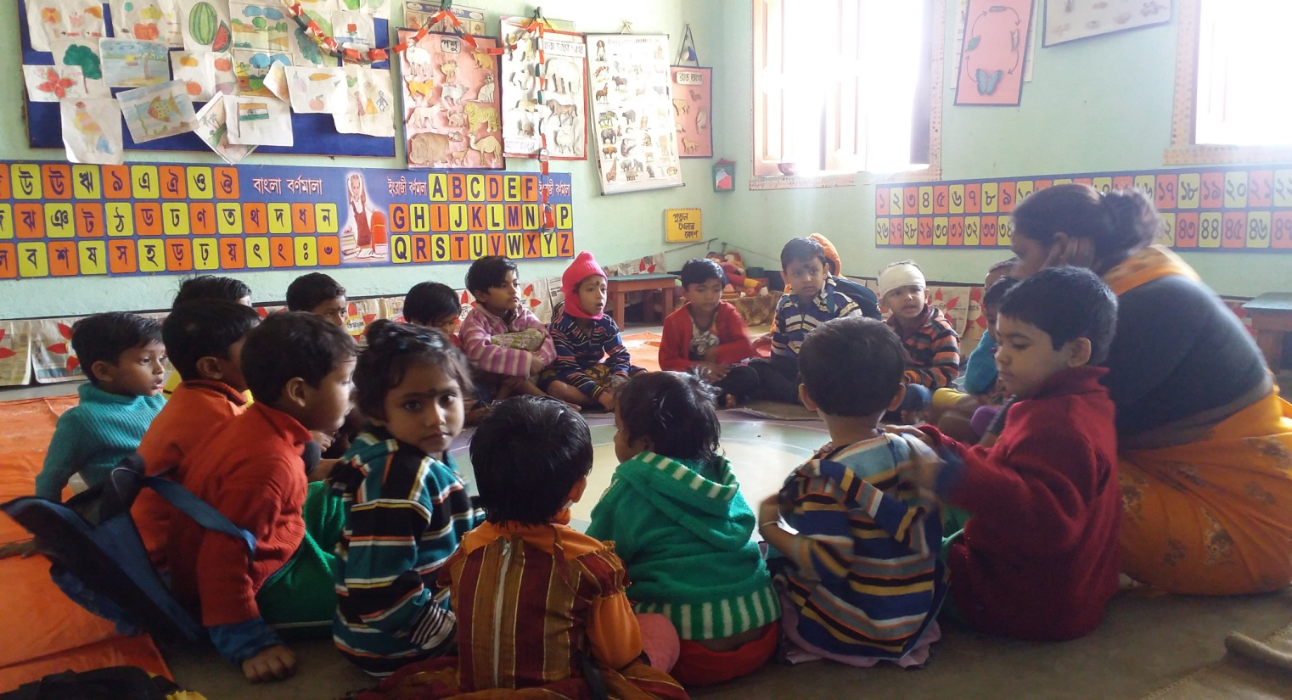
What do we want to do?
Accelerate results for services meant for children

